Slide 1
ADMISSION OF FOREIGNERS FOR STUDIES AT RGGU IN 2023
BA Specialty

Slide 2
The deadlines for submission of documents
Foreigners and Russian citizens have the same conditions in terms of time for the acceptance of documents, the timing of entrance examination and tuition fees.
FREE TUITION AND FEE-PAYING EDUCATION (all forms of education):
from 20 June 2023 to 10 July 2023 («Design», «Art History», «Journalism»)
from 20 June 2023 to 10 July 2023 (if you take the entrance exams to RGGU instead of the Unified State Exam)
from 20 June 2023 to 25 July 2023 (only according to the results of the Unified State Exam)

Slide 3
The deadlines for submission of documents
Foreigners and Russian citizens have the same conditions in terms of time for the acceptance of documents, the timing of entrance examination and tuition fees.
FEE-PAYING EDUCATION (according to the results of the entrance exams to RGGU)
from 20 June 2023 to 10 July 2023 (full-time education, part-time education, extramural studies)
from 2 August 2023 to 10 August 2023 (full-time education, part-time education, extramural studies)
from 20 June to 15 September 2023 (extramural studies using distance learning technologies)

Slide 4
The deadlines for submission of documents
Foreigners and Russian citizens have the same conditions in terms of time for the acceptance of documents, the timing of entrance examination and tuition fees.
FEE-PAYING EDUCATION (according to the results of the United State Exam):
from 20 June 2023 to 25 July 2023 (full-time education, part-time education, extramural studies)
from 2 August 2023 to 16 August 2023 (full-time education, part-time education, extramural studies)
from 1 September 2023 to 15 September 2023 (extramural studies)
from 20 June 2023 to 15 September 2023 (extramural studies using distance learning technologies)

Slide 5
How to submit documents?
Through the personal account of the applicant on the RGGU website https://www.rsuh.ru/abitur/
Personally: Moscow, 15 Chayanova street, building 2;
Through public postal operators

Slide 6
What documents are needed for admission
application for admission;
statement of consent to personal data processing;
passport: notarized copy of passport, notarized translation of passport (if there is no information in Russian in the document), visa page (if you have a visa)
a document of previous education with the supplement /transcript (if it is necessary with legalization/apostille) https://nic.gov.ru/ru/proc/lega):
notarized copy, notarized translation (if the document does not contain information in Russian),
documents confirming individual achievements (certificates, rewards, etc.);
3 photos 3cm*4cm (matte);
medical certificate on form 086/y or health certificate (with fluorography);
medical certificate of absence of HIV/AIDS;
medical insurance policy valid on the territory of the Russian Federation.

Slide 7
It is important
Additionally, you have to provide documents (birth certificate, passport) proving that your parents, grandparents are citizens of the Russian Federation or you were born in the Russian Federation or in the USSR for admission to the program «Compatriots living abroad».
Citizens who have a foreign document of education, should check in advance the need to pass the procedure of recognition of the document of education on the website of the company «Glavexpertcentre» (nostrification)(https://nic.gov.ru/ru/docs/foreign/confirmation).

Slide 8
How can apply for free tuition at RGGU
Not only citizens of the Russian Federation, but also foreigners, stateless persons have the right to study at state-funded places of Russian universities.
Representatives of the following states are:
citizens of the Republic of Belarus, the Republic of Kazakhstan, the Kyrgyz Republic, the Republic of Tajikistan living in their countries;
citizens of the Republic of Azerbaijan, the Republic of Armenia, the Republic of Belarus, the Republic of Kazakhstan, the Kyrgyz Republic, the Republic of Moldova, the Republic of Tajikistan, the Republic of Uzbekistan, Ukraine, Turkmenistan, Georgia, permanently living in the territory of the Russian Federation (having a residence permit);
compatriots living abroad.

Slide 9
Studying at RGGU within the quota for education of foreigners and stateless persons in the Russian Federation
Foreigners have the opportunity to study free of charge within the quota established by the Government of the Russian Federation for the education of foreigners and stateless persons in the Russian Federation.
All information on the website: https://education-in-russia.com/

Slide 10
Contract training for the provision of fee-paying educational services
All foreigners and stateless persons have the opportunity to study at RGGU on a paid basis with a positive result of the entrance examination.
The cost of studying for foreigners is equal to the cost of studying Russian citizens at RGGU.

Slide 11
Entrance exams to RGGU
If foreigners and stateless persons have valid results of the Unified State Exam in general education subjects, the Admission Committee either takes into account the results of the Unified State Exam or admits applicant to the entrance exams in these subjects (at the request of the applicant) conducted by RGGU.

Slide 12
Minimum passing scores for admission to RGGU
Social studies
45
Computer science and ITC
45
Mathematics
39
Other disciplines
40

Slide 13
Health insurance
Visa support
RSUH provides visa support to its students.
You have to provide an order for enrollment or a study contract and a paid receipt to issue a visa invitation.
Contacts of the Visa Department:
Email: welcome@rggu.ru Phone: + 7 (495) 250-63-54
Foreign students who come to study at RGGU are required to make a medical insurance policy valid on the territory of the Russian Federation.
The necessary information on insurance issues can be obtained here:
Email : inter@rggu.ru Phone: + 7 (495) 250-65-16

Slide 14
Dormitory
Website of the RGGU dormitory: https://www.rsuh.ru/hostel/
Extracurricular activities
There is an active extracurricular activity at the RGGU.
More detailed: https://www.rsuh.ru/student/our- activities/

Slide 15
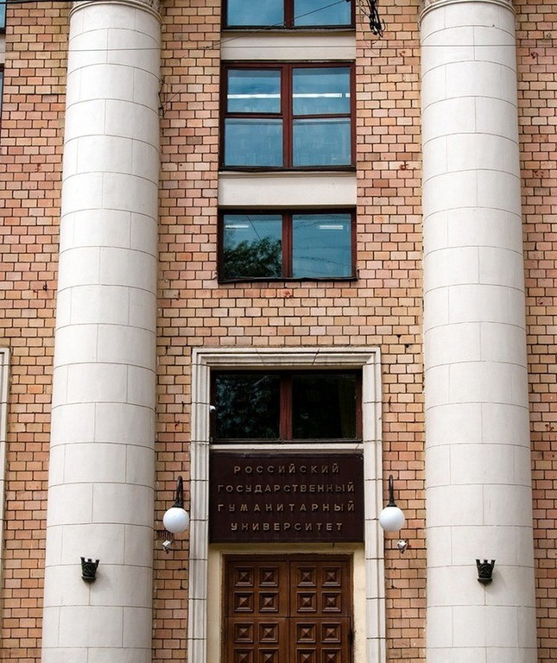
CONTACTS
Admissions Committee for foreigners :
+7 (495) 250-65-14, 250-61-80
inter@rggu.ru
https://www.rsuh.ru/applicant/admissions-2021/
International Department:
inter@rggu.ru
https://www.rsuh.ru/international/international-relations-office/
Distance Education Centre:
+7 (495) 250-61-10, +7 (495) 250-61-11
priem.do@rggu.ru https://www.rsuh.ru/dot/coming.php
Department of Fee-Paying Education Services:
+7 (495) 250-66-25
upou2@rggu.ru https://www.rsuh.ru/applicant/section_139/

Slide 16
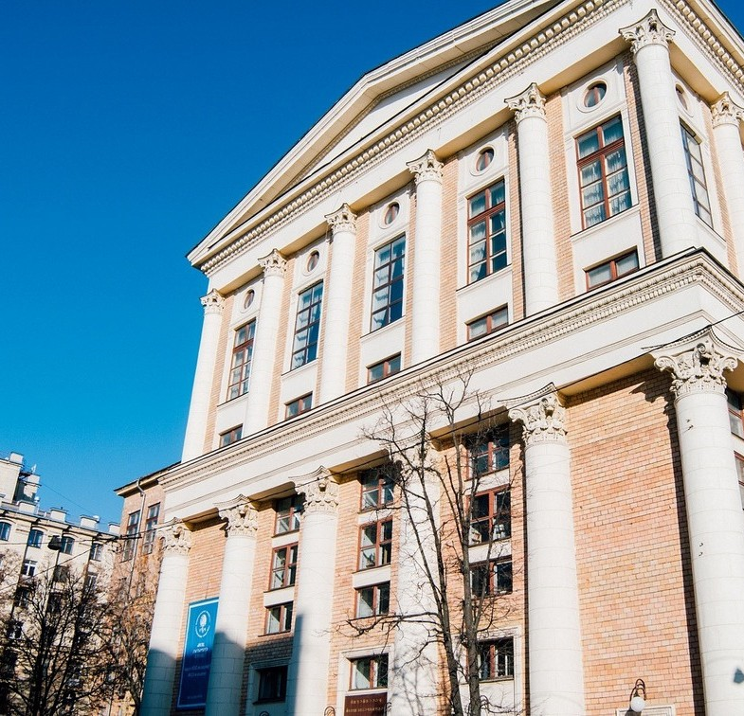
CONTACTS
Preparatory courses for the United State Exam, State Final Assessment, entrance exams of RGGU:
+7 (495) 250-71-48
kursy@rggu.ru , licey@rggu.ru http://cdo.rggu.ru/section.html?id=12533
Inclusive education at RGGU:
https://www.rsuh.ru/education/inclusive/
Student Affairs Department: https://www.rsuh.ru/student/about-department/
Dormitory:
https://www.rsuh.ru/hostel/

Slide 17
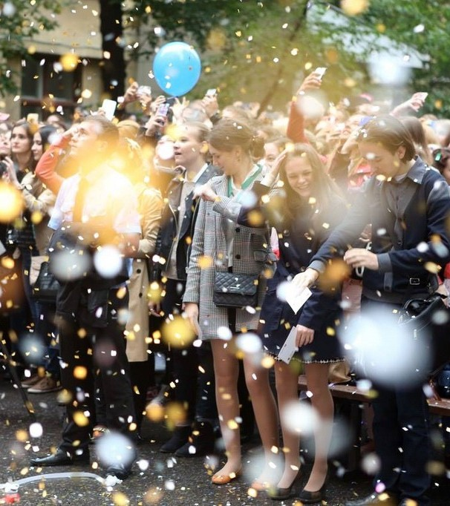
Useful links
Ministry of Science and Higher Education of the Russian Federation: https://www.minobrnauki.gov.ru/
Main State Centre for Education Evaluation (Glavexpertcentre):
https://nic.gov.ru/
Information portal«Future in Russia»:
https://future-in-russia.com/
The Federal Agency for the Commonwealth of Independent States Affairs, Compatriots Living Abroad, and International Humanitarian Cooperation (Rossotrudnichestvo):
http://rs.gov.ru/%20/about

Slide 18
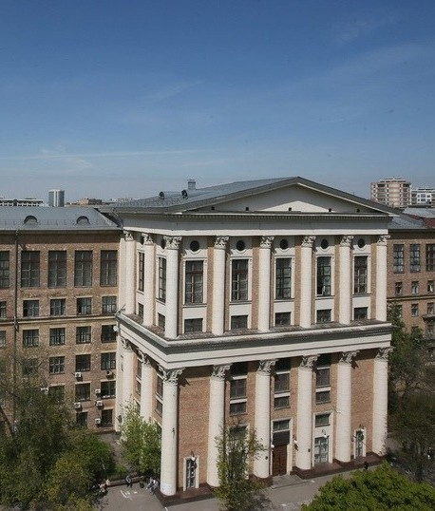
International Department
Admissions Committee for international students
Phone: +7 (495) 250-65-14, +7 (495) 250-61-80
Email : inter@rggu.ru

